Slide 1


Cell Type Embeddings Test 7 / Branislav Popović

Slide 2
Dataset Analysis
H5AD data format
1123 observations x 22468 features (set of gene expressions)
limited dataset vs. high-dimensional feature vectors
-> reduced complexity + regularization to avoid overtraining
-> feature normalization (scaling) improves convergence and mitigates issues such as exploding/vanishing gradients, acting as a form of regularization
5 cell types
glomerular layer (GL)
granule cell layer (GCL)
mitral cell layer (MCL)
olfactory nerve layer (ONL)
rostral migratory stream (RMS)
-> use cell type annotations in a supervised learning scenario to increase the quality of the obtained embeddings

Slide 3
Autoencoder Architecture
Train a deep learning model based on an autoencoder to generate low-dimensional representations (embeddings) of gene expressions (Linear + ReLU + Linear)
reconstruction loss
22468
256
256
22468
embeddings
(latent dim)
5
class labels
classification (cross-entropy) loss

Slide 4
Autoencoder Training
100 epochs (max)
Stopping criterion based on validation loss, batch size 32
Training loss
Reconstruction criterion: MSELoss()
Classification criterion: CrossEntropyLoss()
Adam optimizer (learning rate 0.001)
90% training, 10% validation
use of complete dataset -> perfect classification, not generalizable

Slide 5
Quality of Embeddings
Project autoencoder embeddings onto 2 dimensions using Principal Component Analysis and Uniform Manifold Approximation and Projection.
PCA is dimensionality reduction technique employing eigenvalue decomposition, using principal components (eigenvectors) representing the directions of maximum variance in the data.
UMAP is a nonlinear dimensionality reduction technique preserving both local and global structure of high-dimensional data in a low-dimensional space by constructing a high-dimensional fuzzy topological representation of the data and optimally embedding this representation into a lower-dimensional space through a combination of repulsive and attractive forces.

Slide 6
Objective Estimates
Silhouette score [-1, 1] ↑
measures how similar an object is to its cluster (cohesion) compared to other clusters (separation)
Classification accuracy [val. set, %] ↑
logistic regression (max 1000 iterations)
Cluster distances
Inter-cluster distance (average distance to points in other clusters) ↑
Intra-cluster distance (average distance within the cluster) ↓

Slide 7
Enhance Embeddings
Hypothesis:
cell type is corelated with coordinate information (position of each cell)
Idea:
incorporate cell coordinate information (if available) into the training process
e.g., concatenate the cell coordinates (obtained from spatial transcriptomics or other spatial information) with the gene expression data as additional features and train the autoencoder on augmented data
this can potentially help the autoencoder to learn more informative representations that capture both spatial and gene expression patterns simultaneously, leading to more meaningful embeddings

Slide 8
PCA Embeddings Test Results

Slide 9

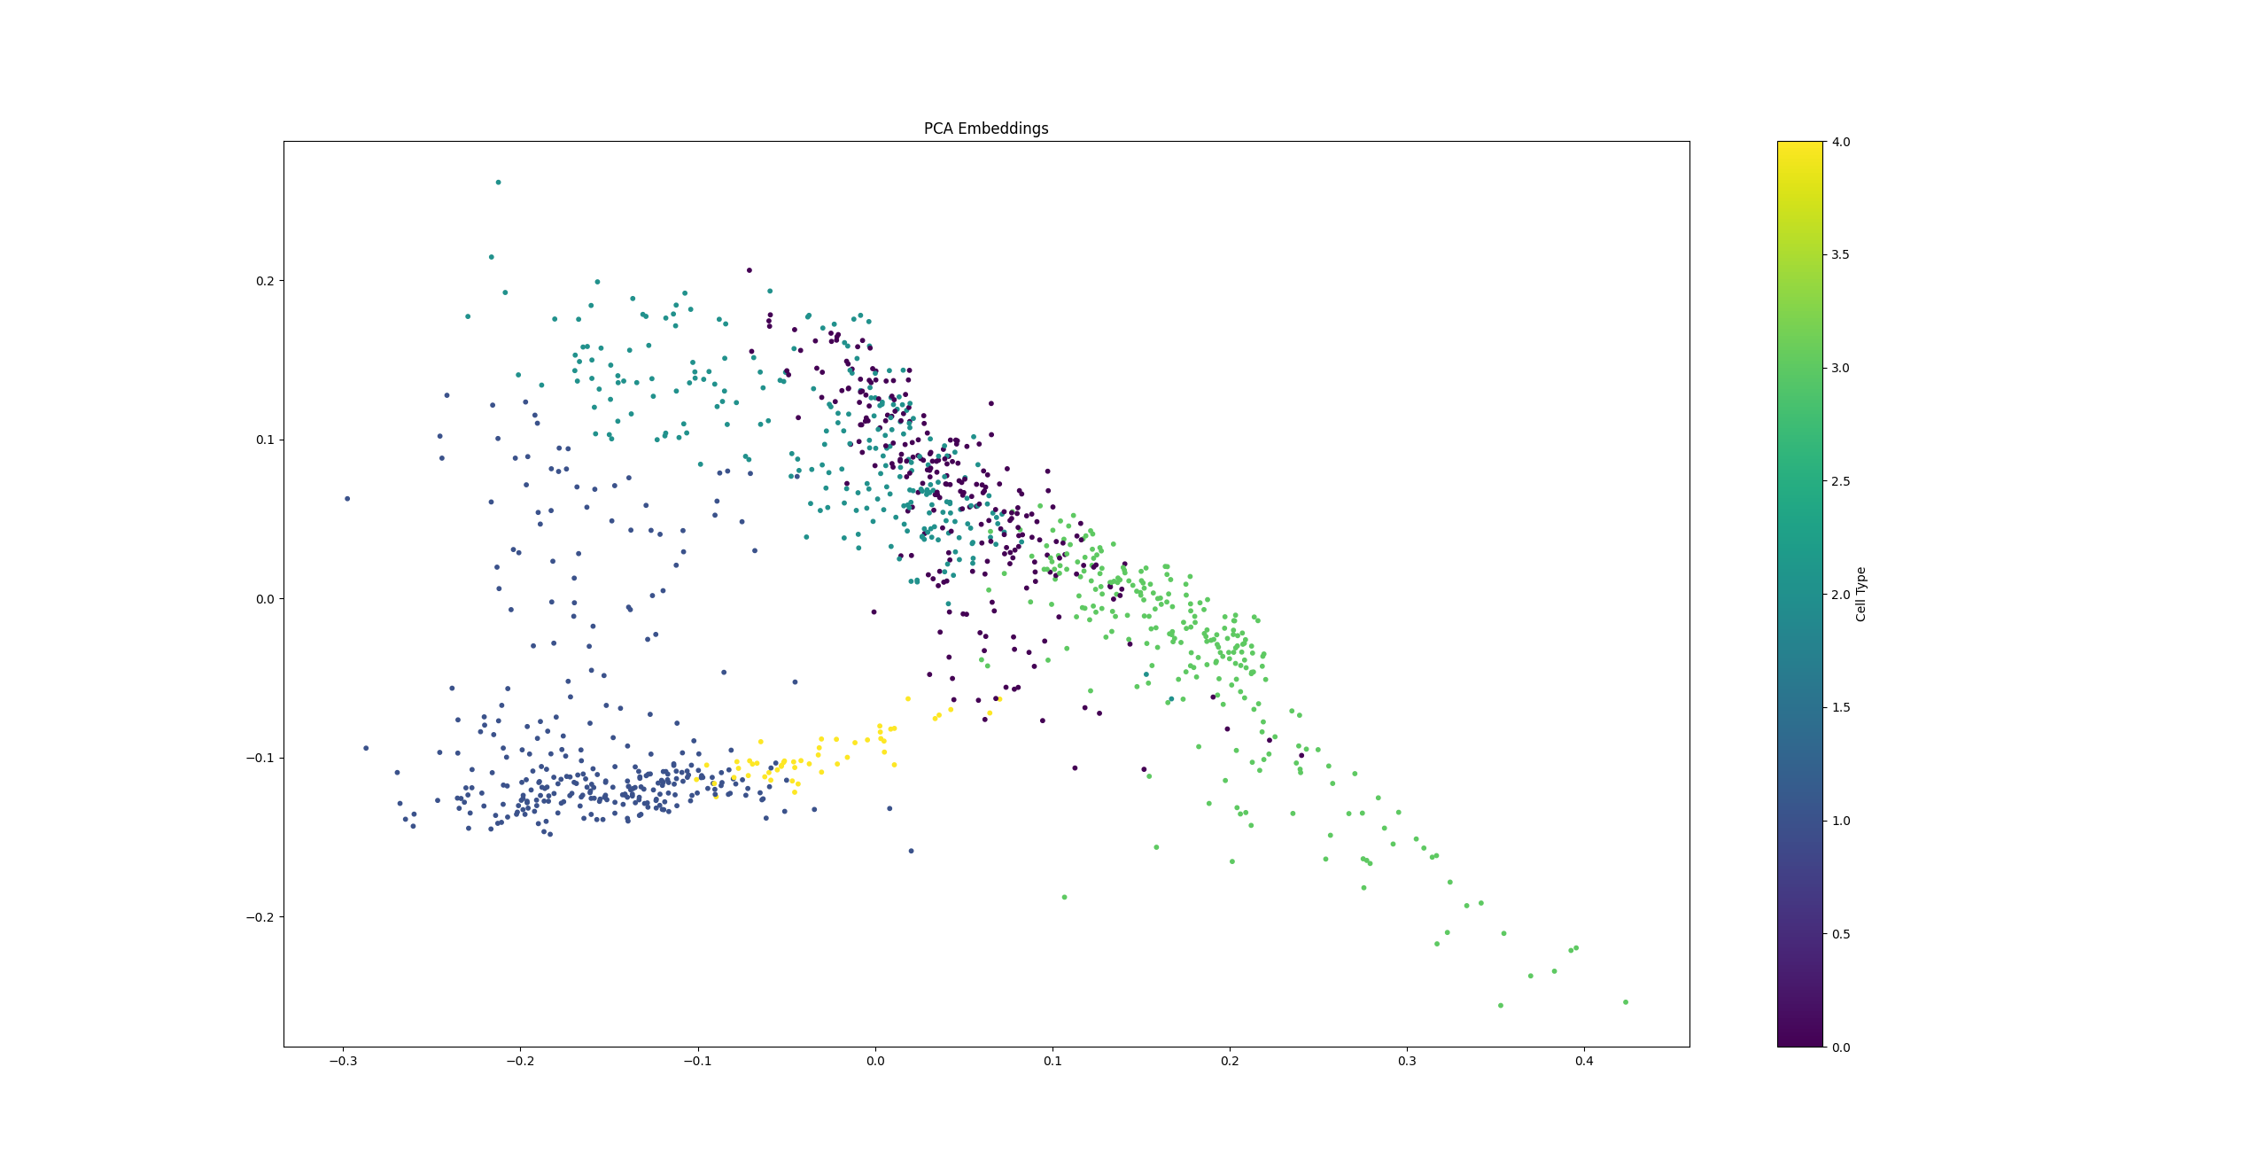
Baseline Results (PCA)
No autoencoder
silhouette score: 0.1896
classification accuracy: 67.26%
inter-cluster distance: 0.2296
intra-cluster distance: 0.0913

Slide 10
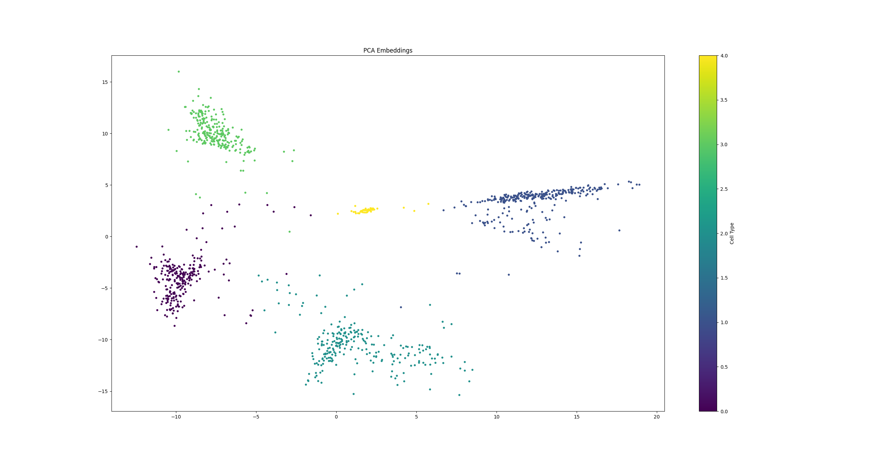
Autoencoder Results (PCA)
Embedding size: 8 (10% val)
silhouette score: 0.7243
classification accuracy: 85.84%
inter-cluster distance: 17.2332
intra-cluster distance: 2.6480

Slide 11
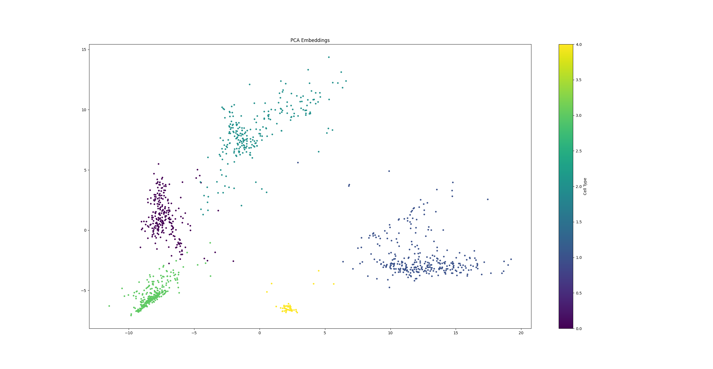
Autoencoder Results (PCA)
Embedding size: 16 (10% val)
silhouette score: 0.6694
classification accuracy: 83.19%
inter-cluster distance: 14.4940
intra-cluster distance: 2.4319

Slide 12
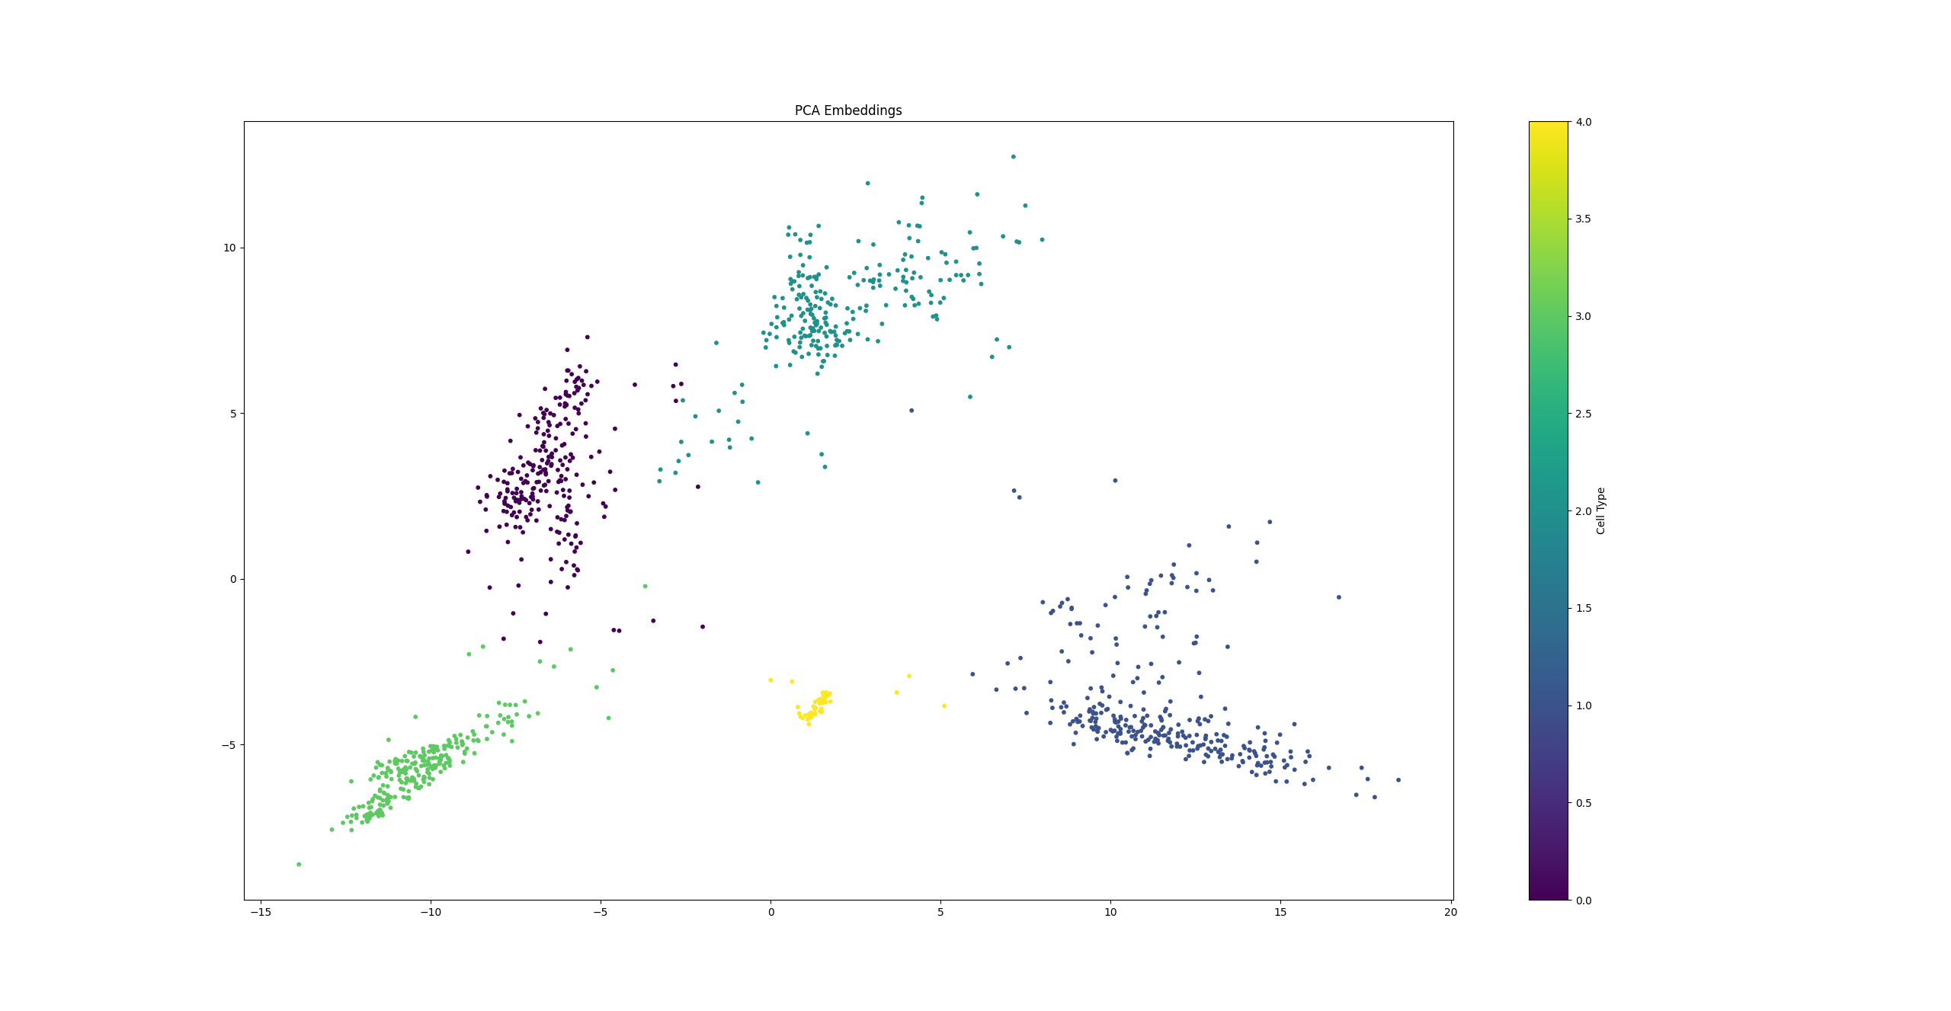
Autoencoder Results (PCA)
Embedding size: 32 (10% val)
silhouette score: 0.7016
classification accuracy: 85.84%
inter-cluster distance: 14.8937
intra-cluster distance: 2.3733

Slide 13
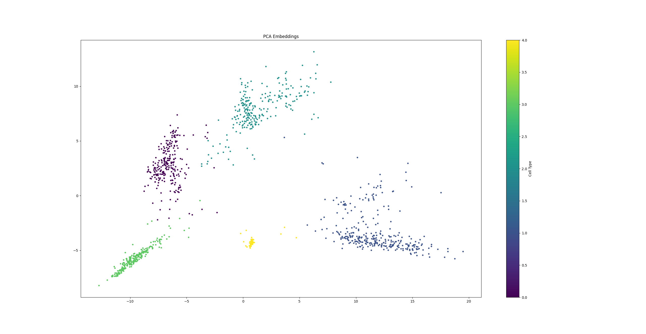
Autoencoder Results (PCA)
Embedding size: 64 (10% val)
silhouette score: 0.6954
classification accuracy: 87.61%
inter-cluster distance: 14.5940
intra-cluster distance: 2.3982

Slide 14
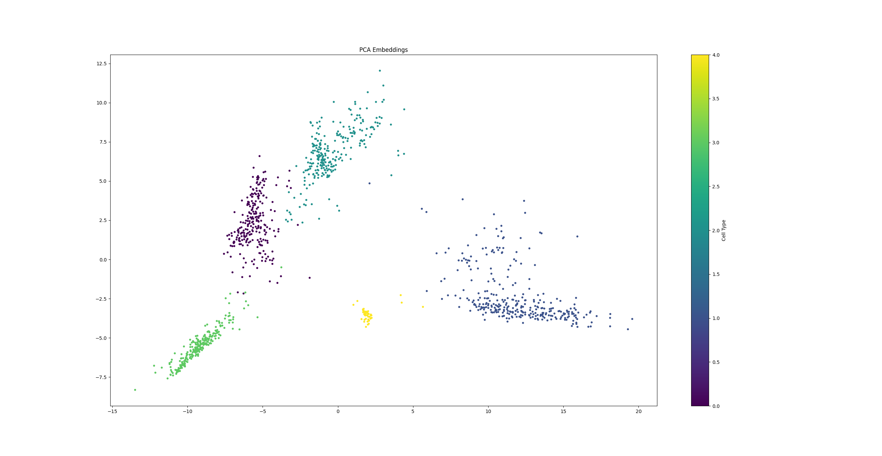
Autoencoder Results (PCA)
Embedding size: 96 (10% val)
silhouette score: 0.6650
classification accuracy: 83.19%
inter-cluster distance: 13.6441
intra-cluster distance: 2.2334

Slide 15
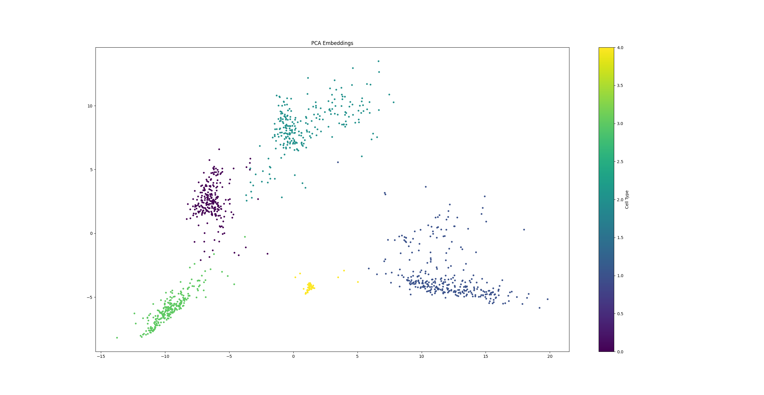
Autoencoder Results (PCA)
Embedding size: 128 (10% val)
silhouette score: 0.6903
classification accuracy: 87.61%
inter-cluster distance: 14.7650
intra-cluster distance: 2.4166

Slide 16

PCA Charts

Slide 17
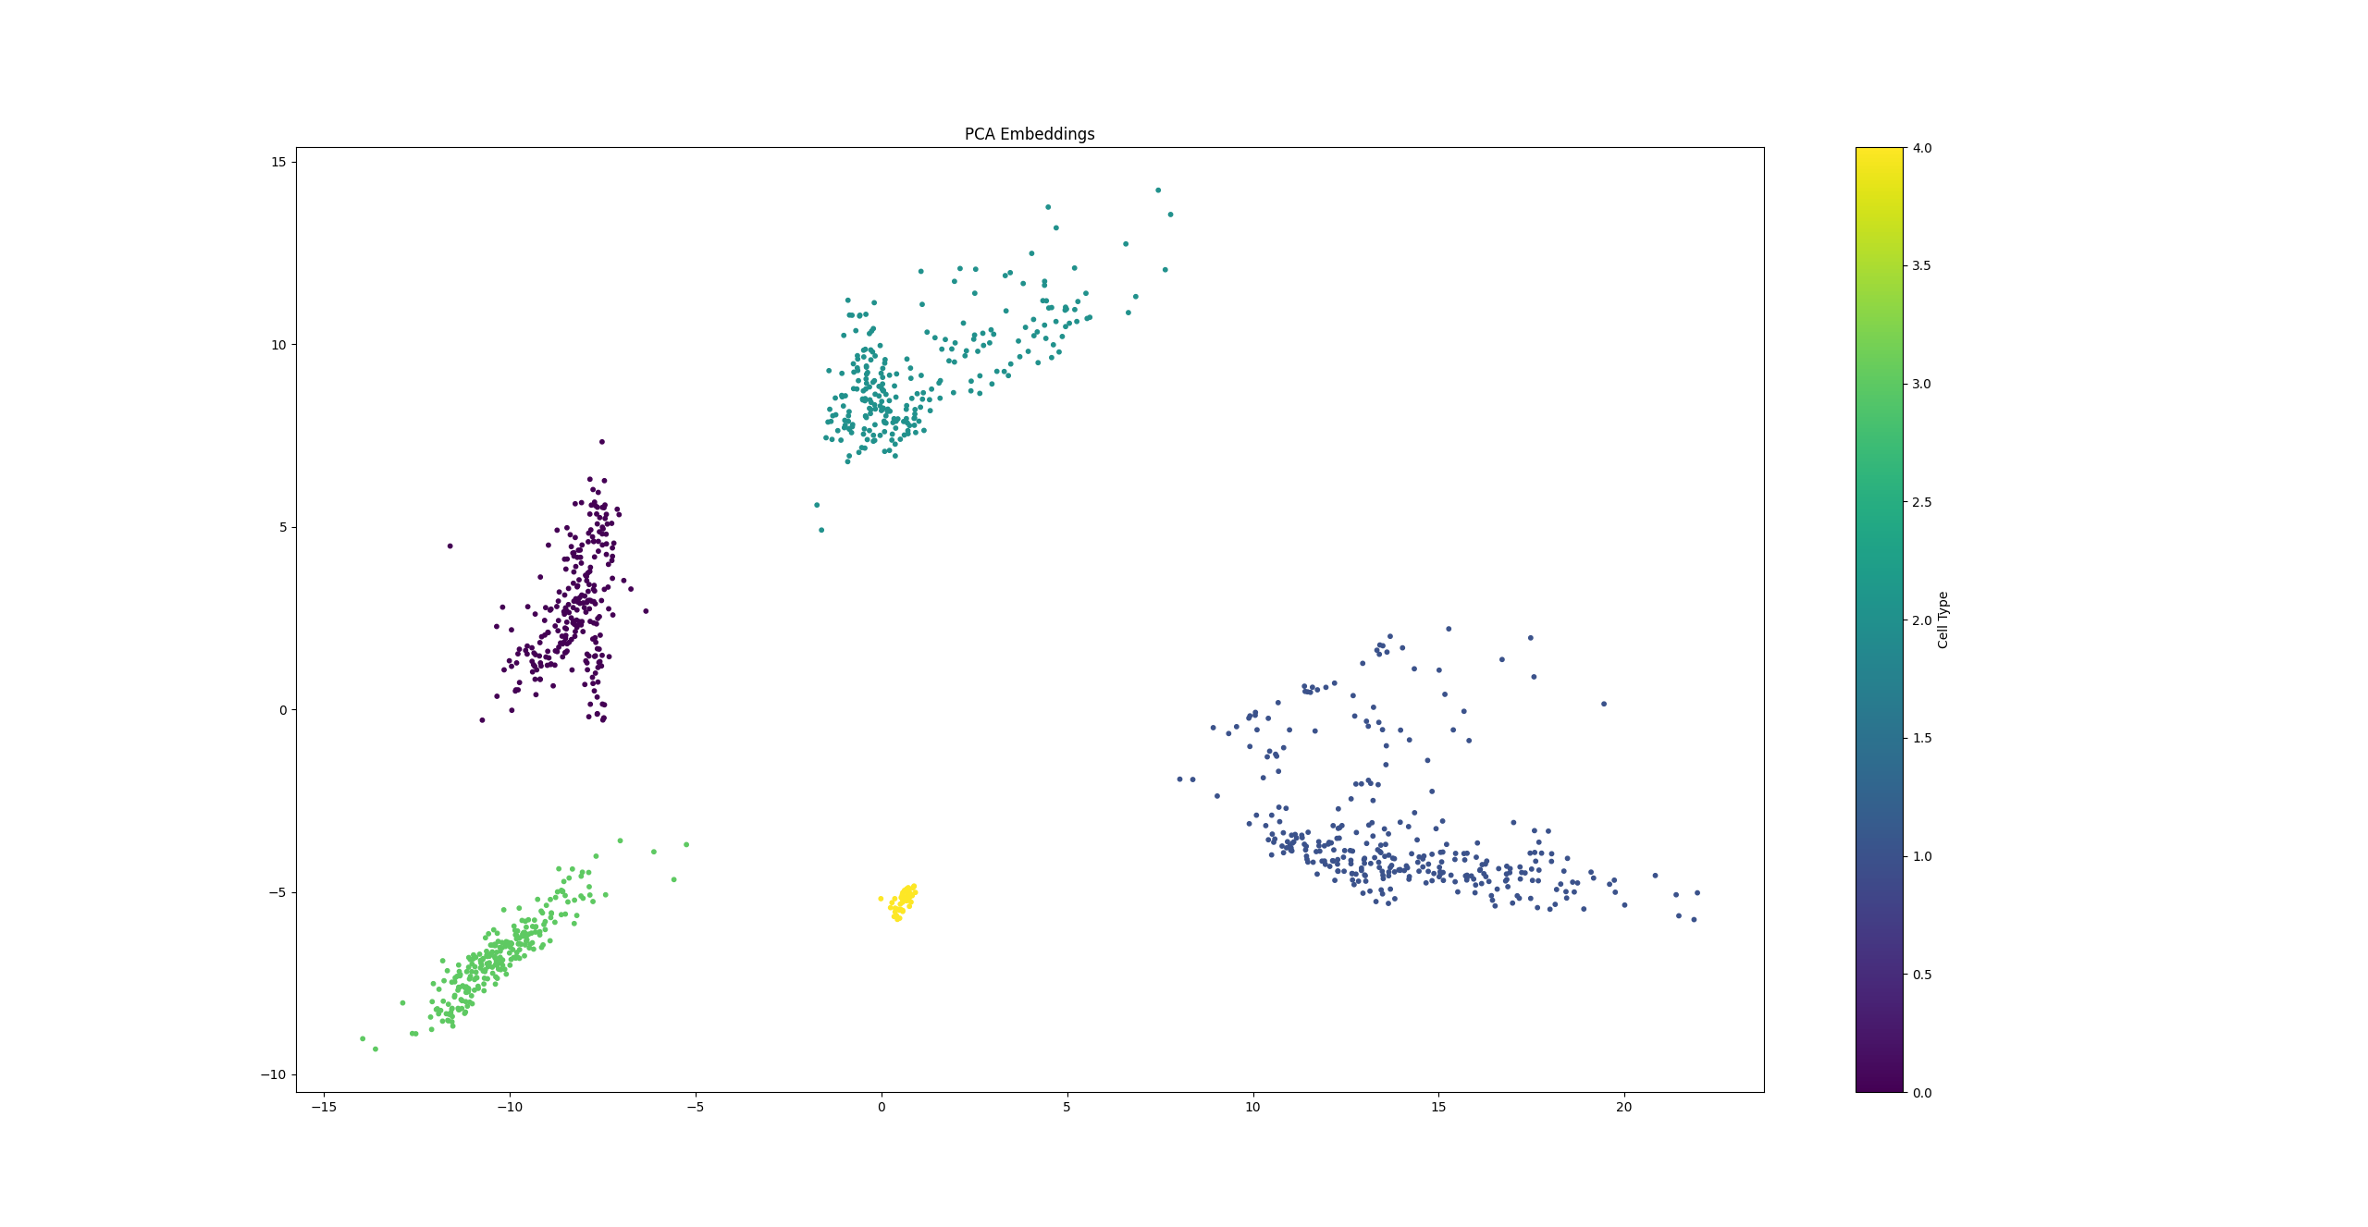
Autoencoder Results (PCA)
Embedding size: 64 (100% train)
silhouette score: 0.7608
classification accuracy: 100.00%
inter-cluster distance: 16.8052
intra-cluster distance: 2.2420

Slide 18
UMAP Embeddings Test Results

Slide 19
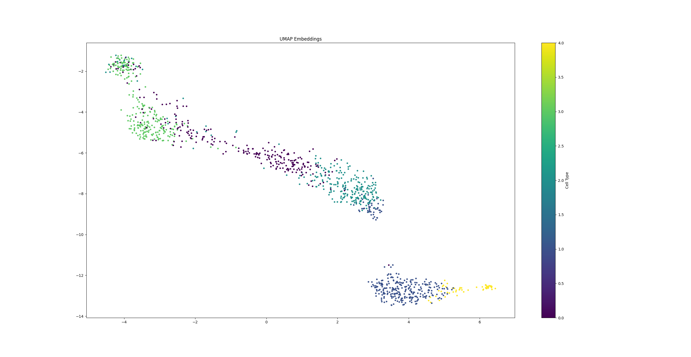
Baseline Results (UMAP)
No autoencoder
silhouette score: 0.2249
classification accuracy: 77.88%
inter-cluster distance: 6.8356
intra-cluster distance: 1.8450

Slide 20
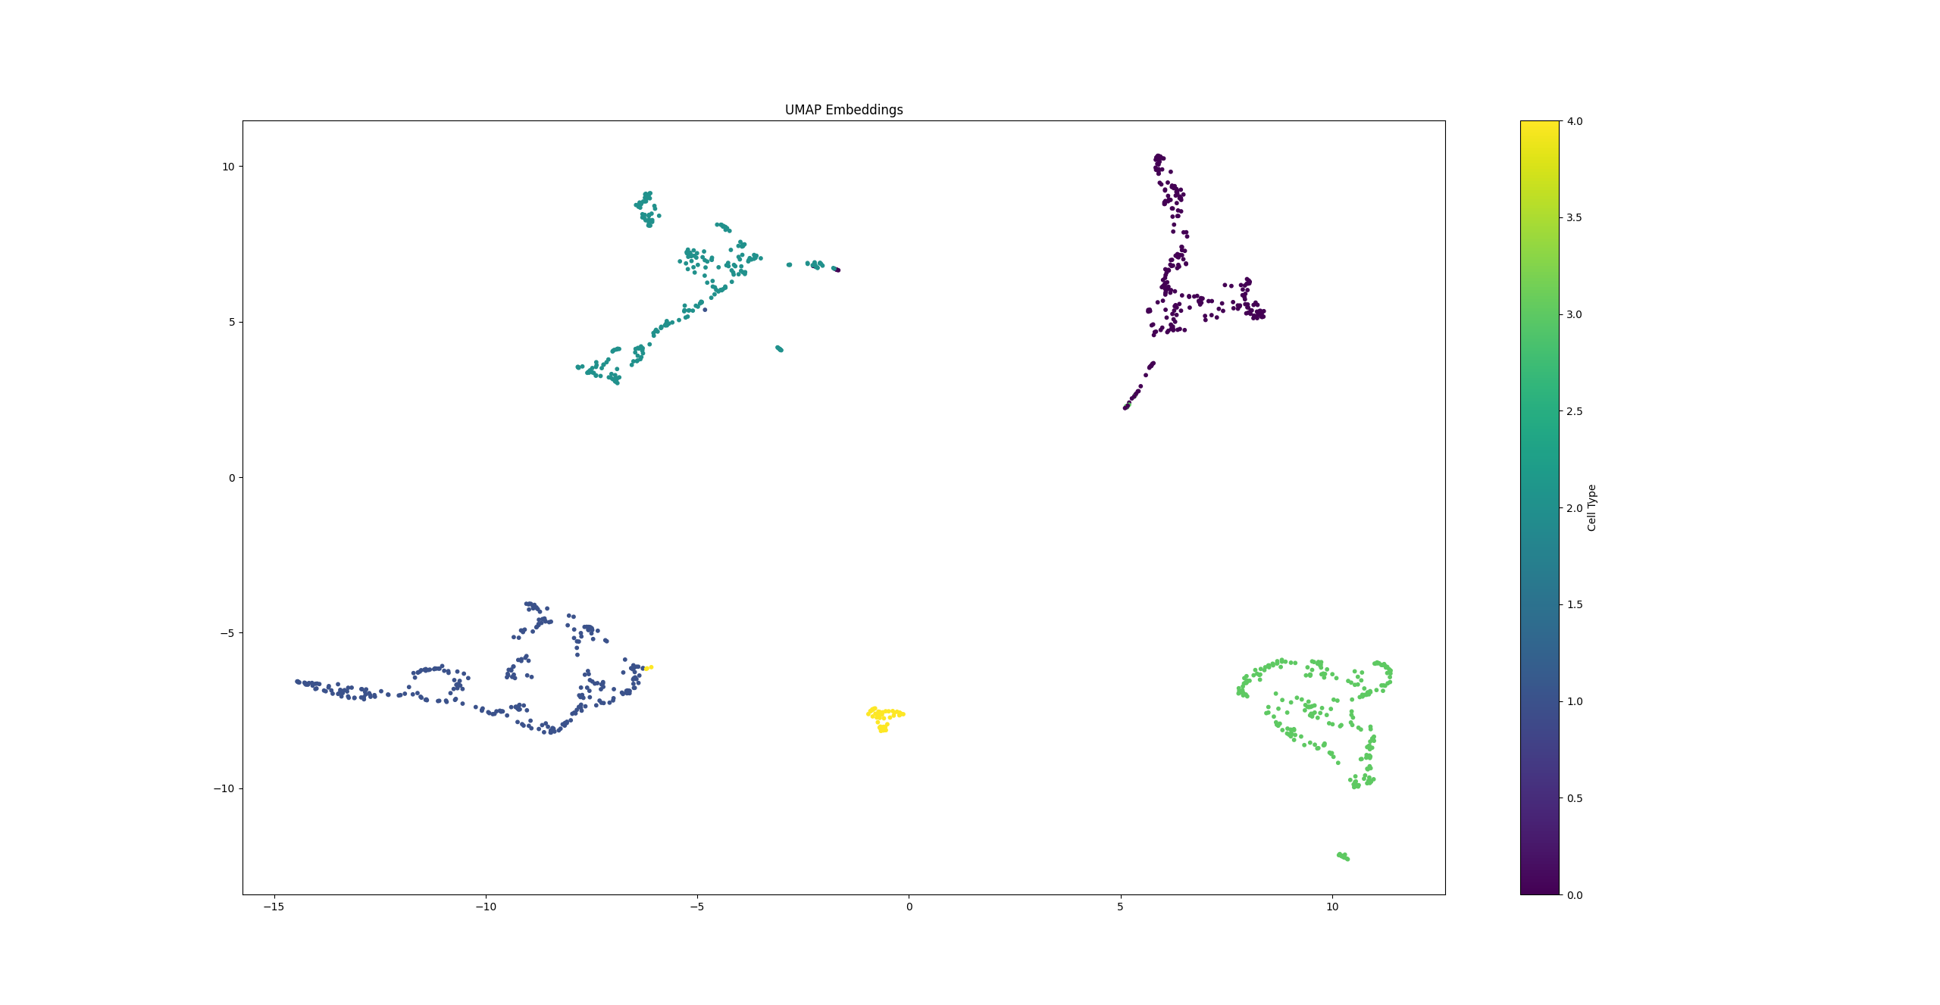
Autoencoder Results (UMAP)
Embedding size: 8 (10% val)
silhouette score: 0.7114
classification accuracy: 86.73%
inter-cluster distance: 15. 7594
intra-cluster distance: 2.5253

Slide 21
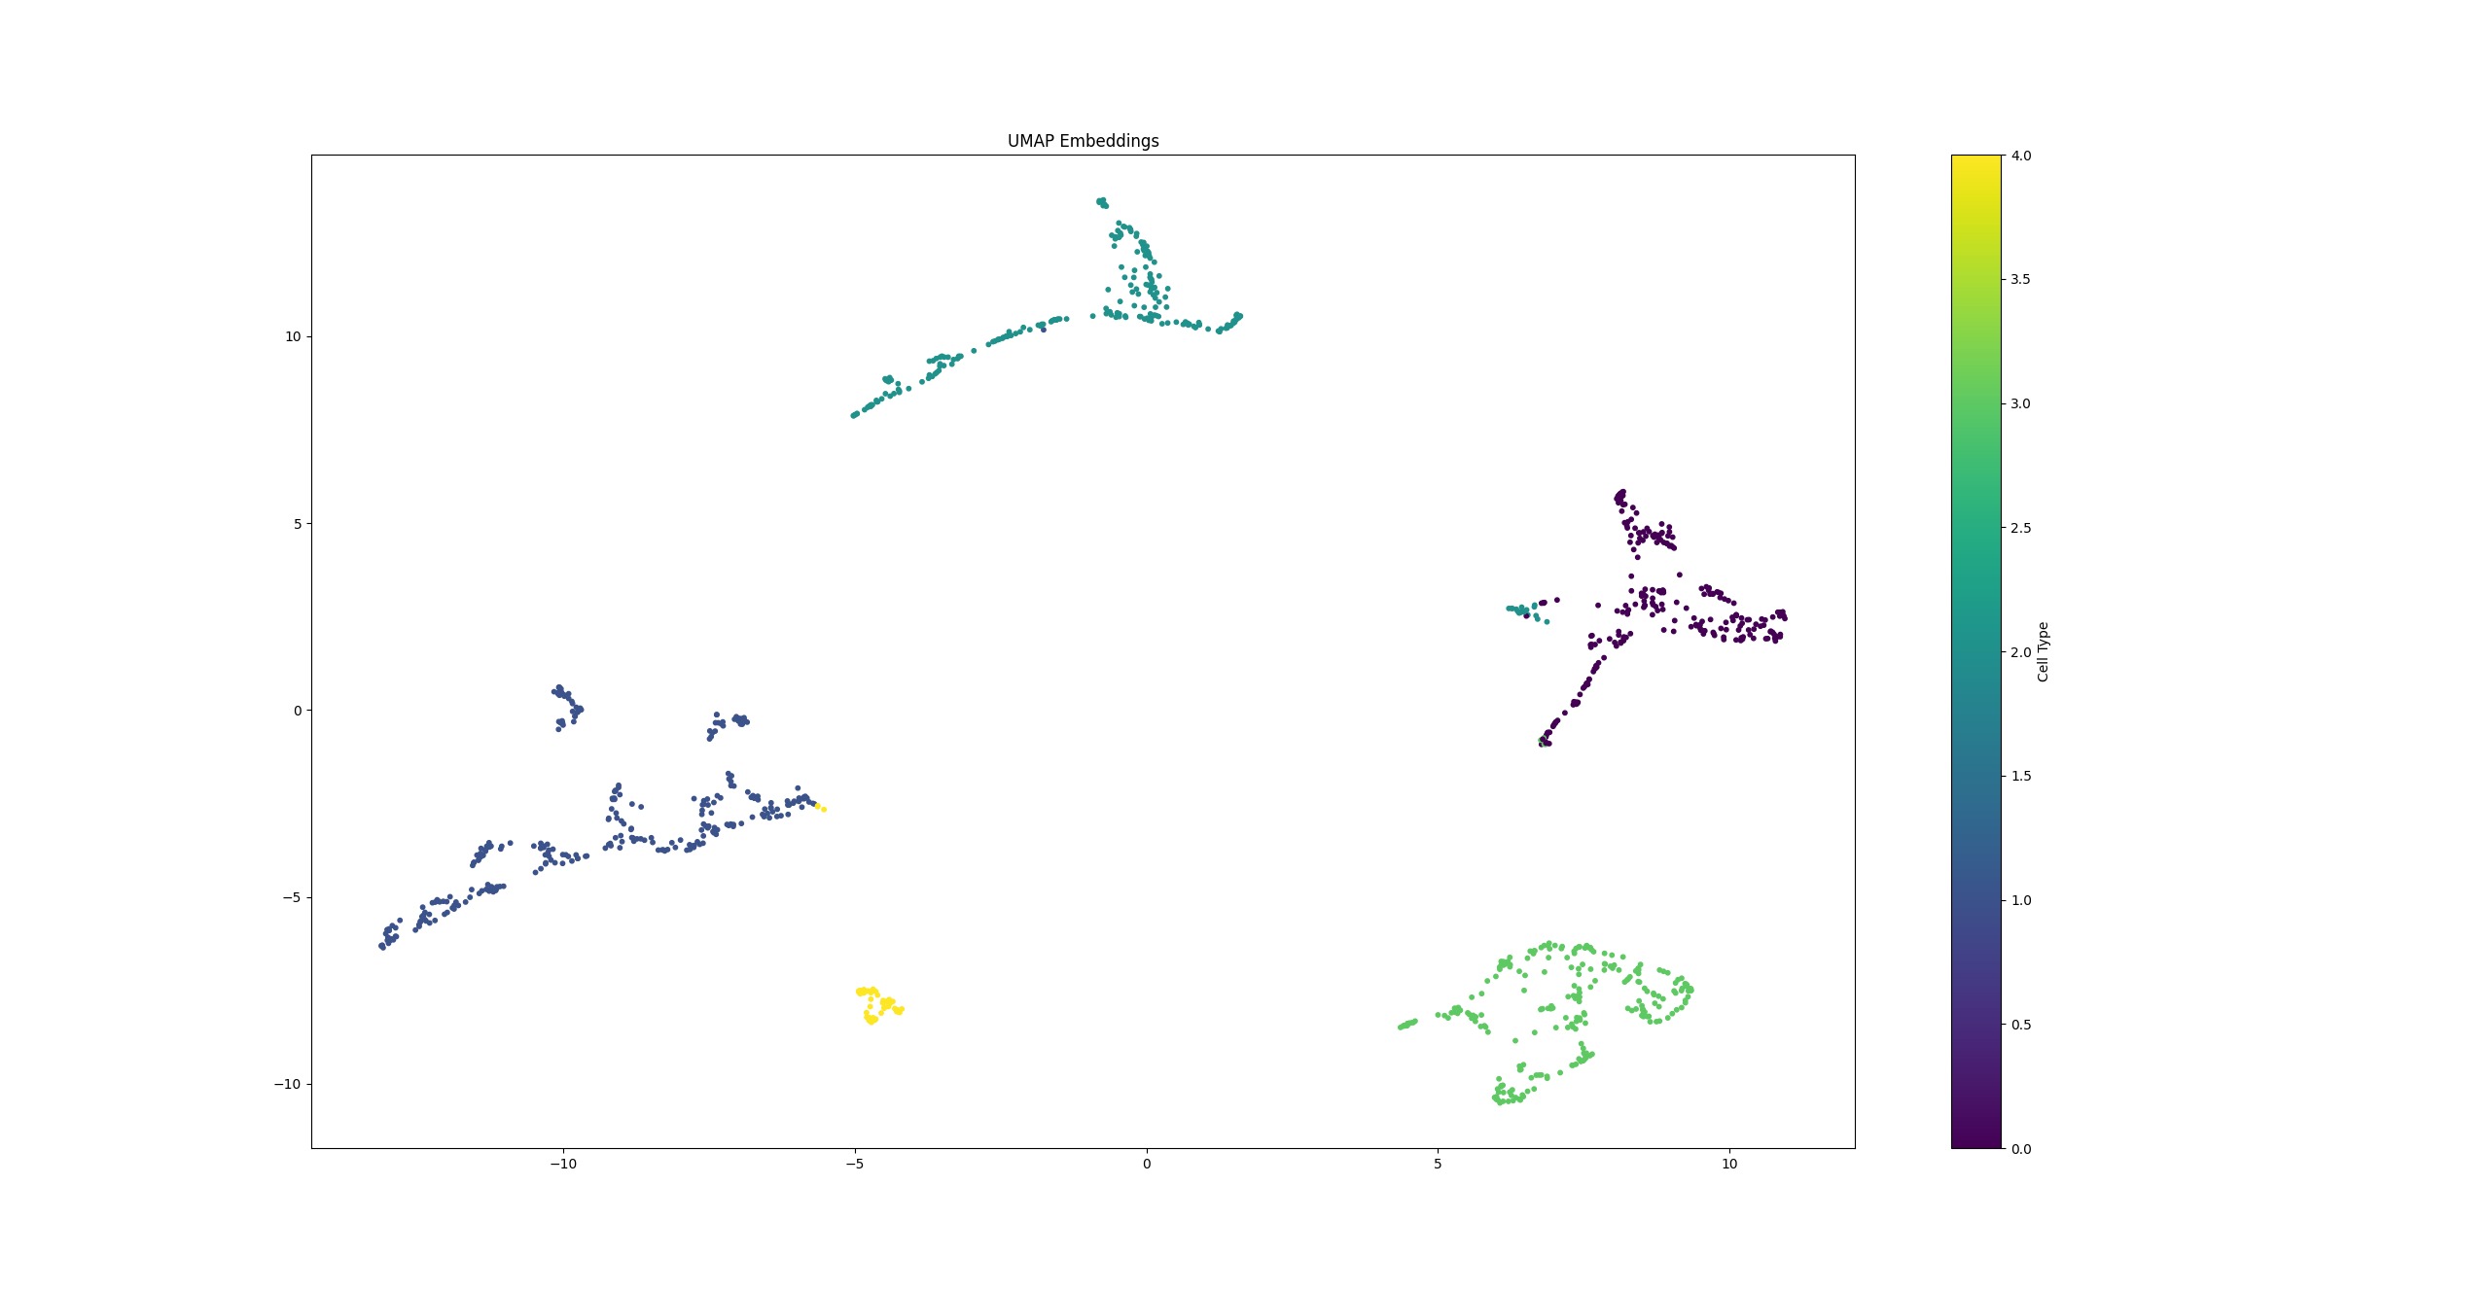
Autoencoder Results (UMAP)
Embedding size: 16 (10% val)
silhouette score: 0.6493
classification accuracy: 75.22%
inter-cluster distance: 15.3178
intra-cluster distance: 2.6988

Slide 22
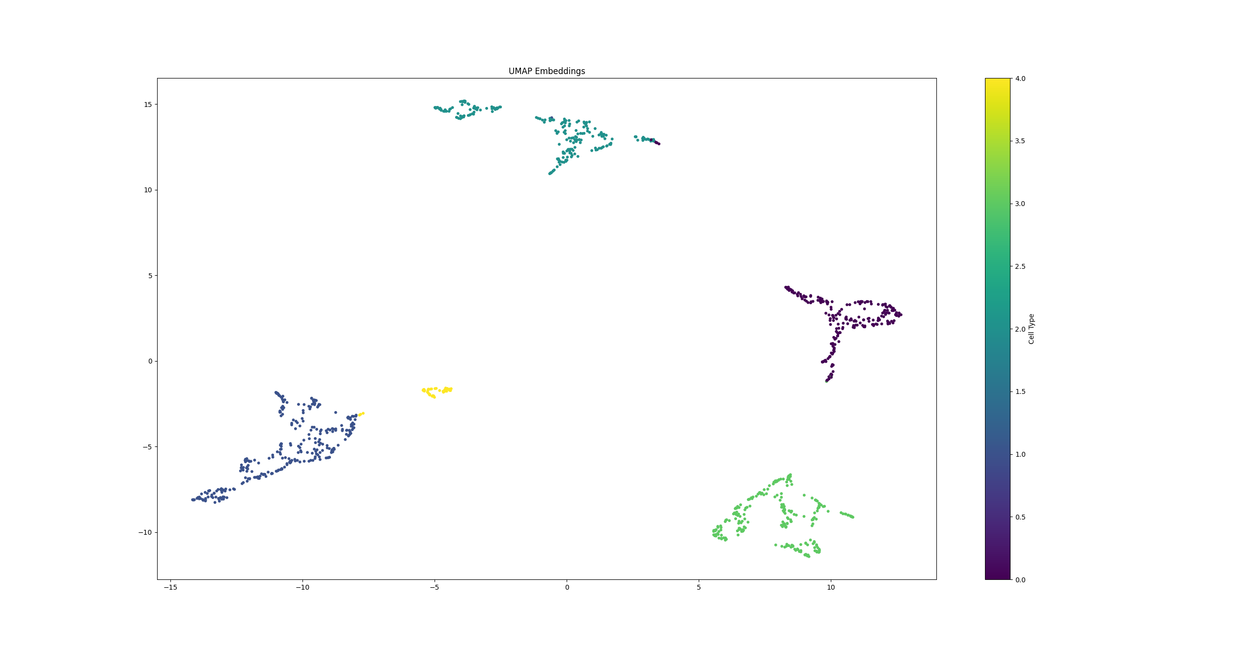
Autoencoder Results (UMAP)
Embedding size: 32 (10% val)
silhouette score: 0.6947
classification accuracy: 87.61%
inter-cluster distance: 17.7771
intra-cluster distance: 2.4488

Slide 23
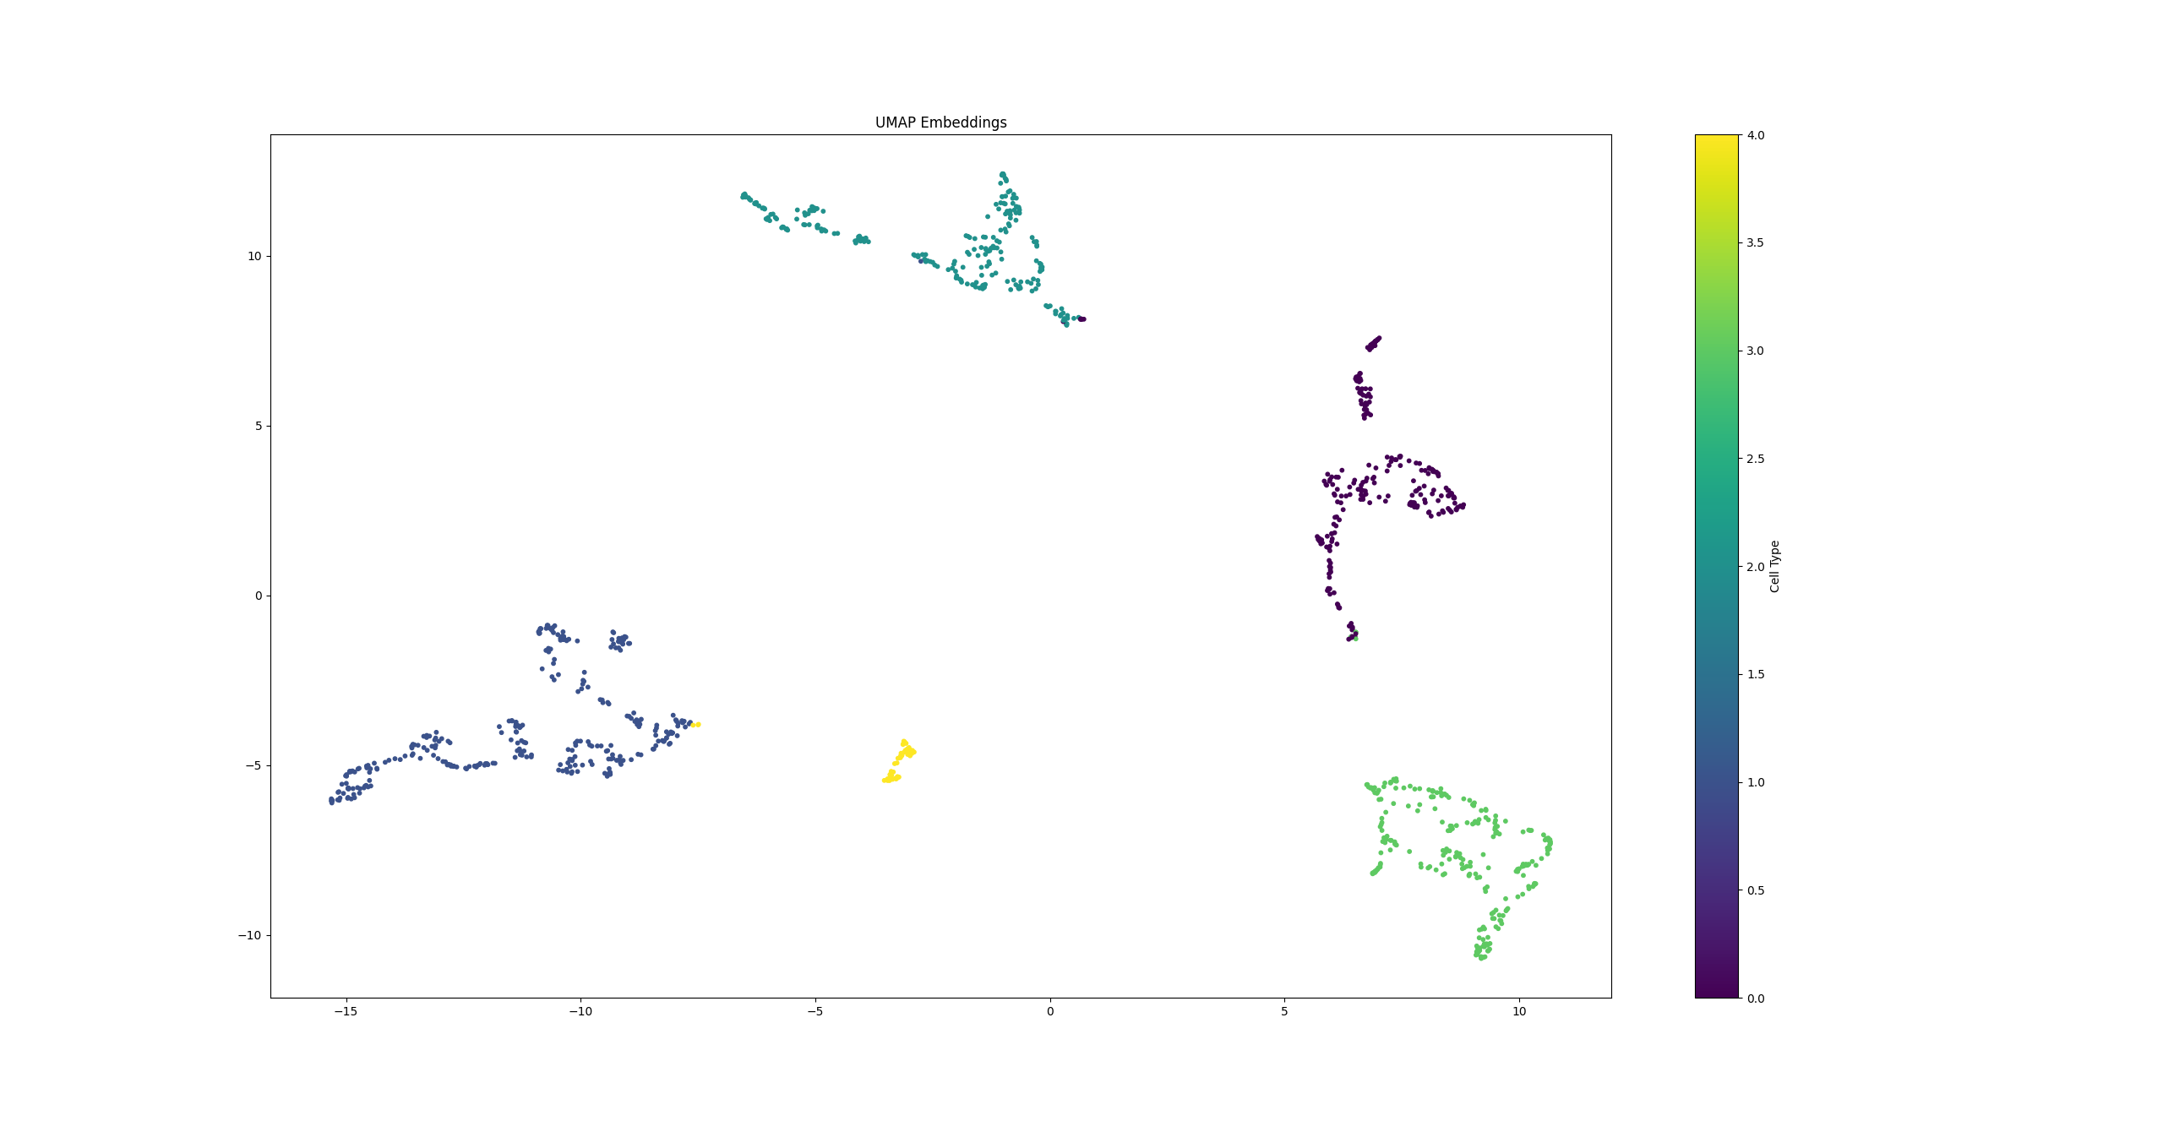
Autoencoder Results (UMAP)
Embedding size: 64 (10% val)
silhouette score: 0.6829
classification accuracy: 87.61%
inter-cluster distance: 15.8059
intra-cluster distance: 2.5474

Slide 24
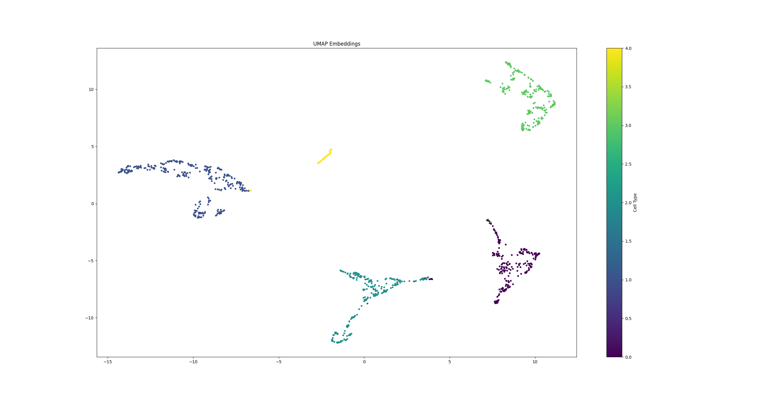
Autoencoder Results (UMAP)
Embedding size: 96 (10% val)
silhouette score: 0.6784
classification accuracy: 87.61%
inter-cluster distance: 15.5445
intra-cluster distance: 2.5374

Slide 25
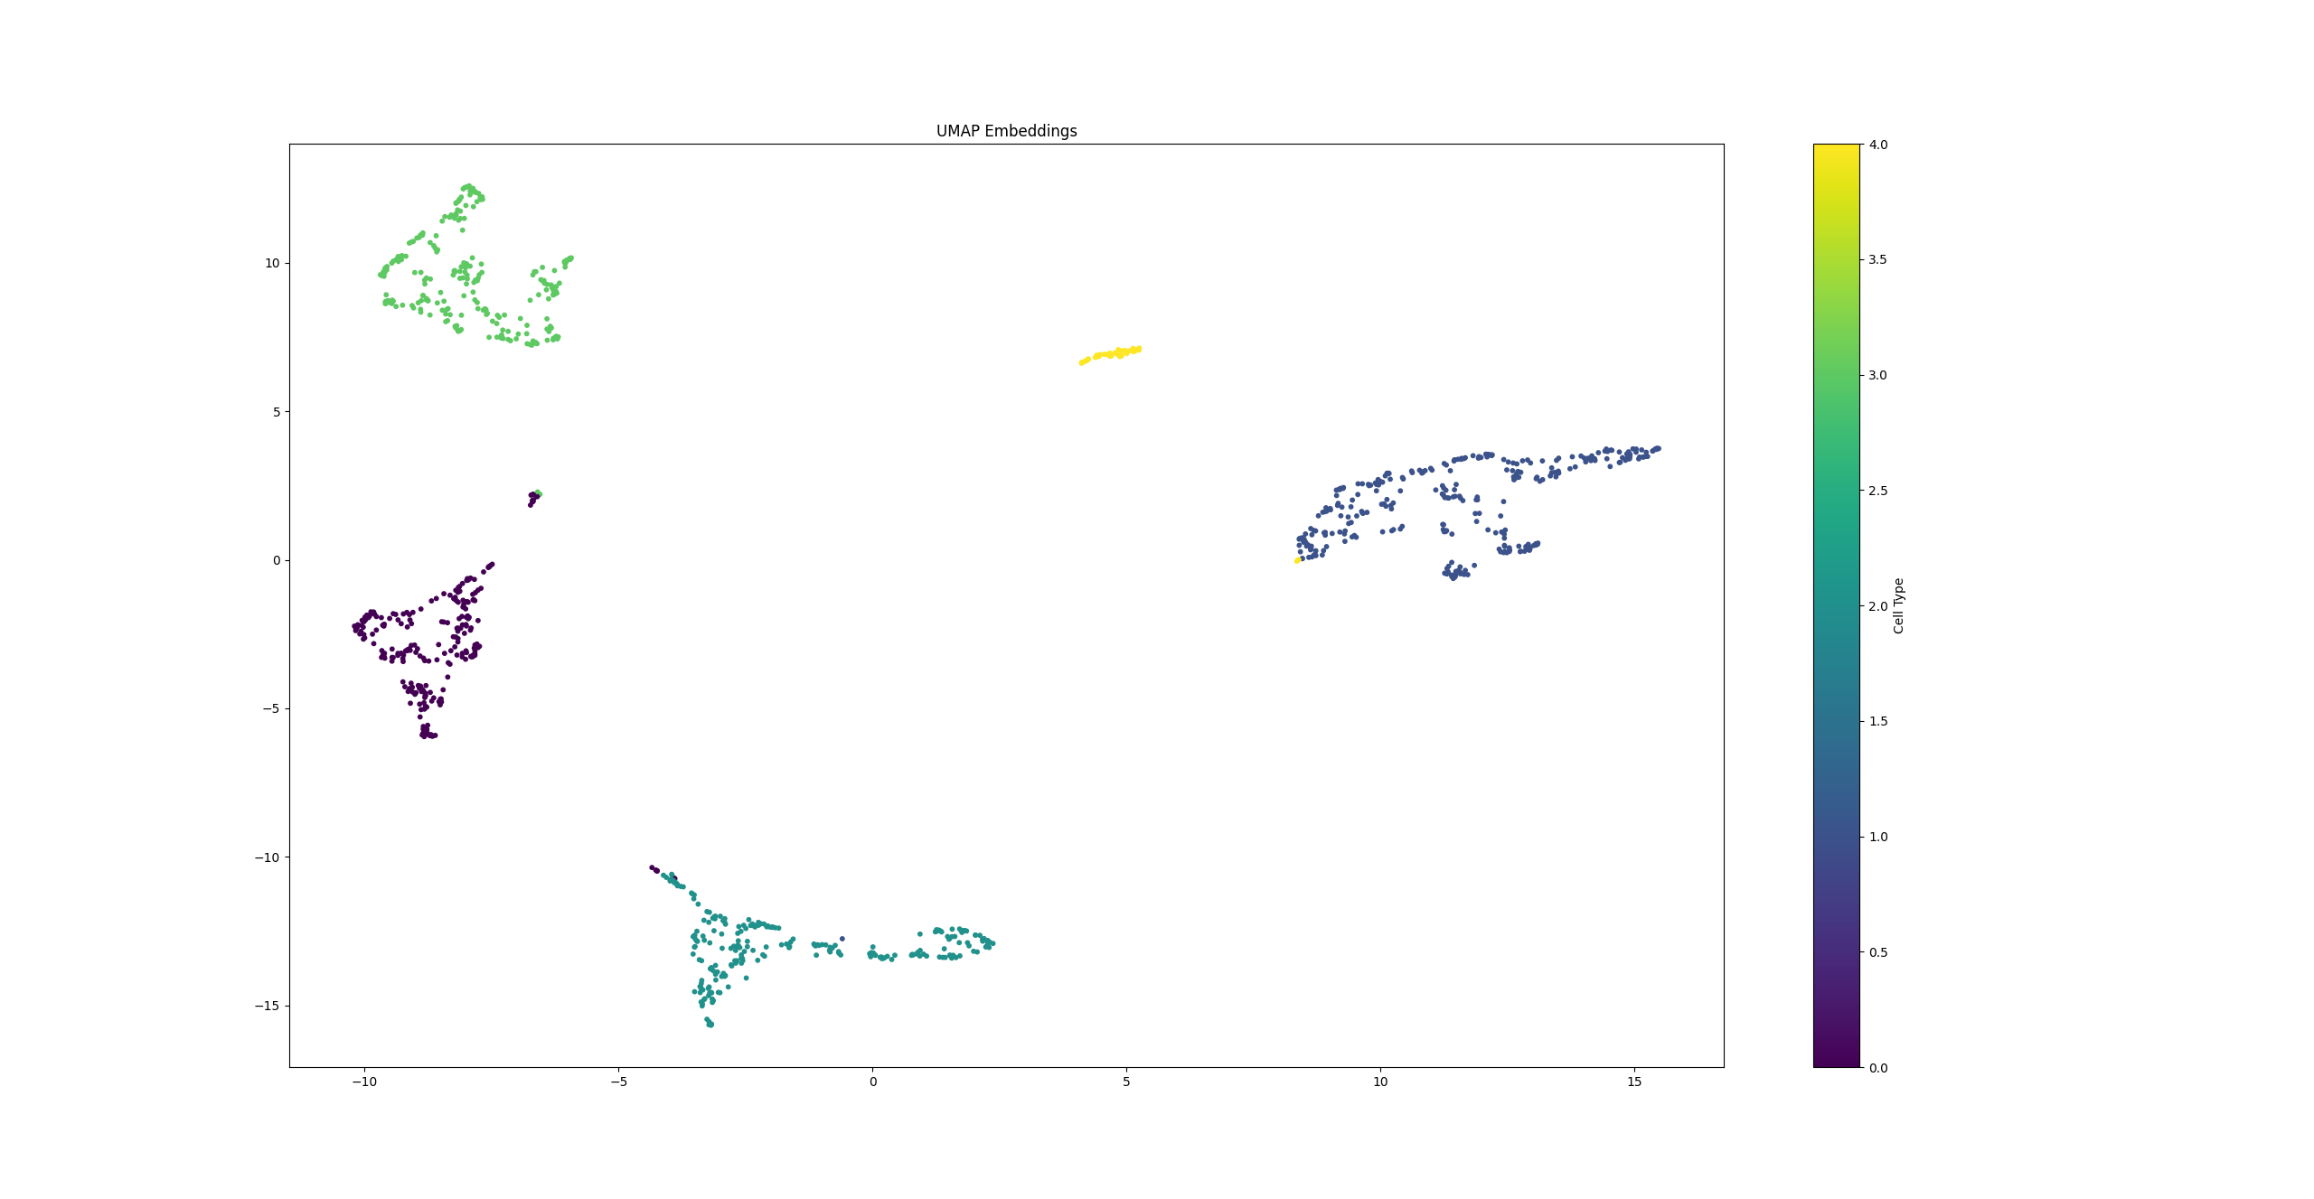
Autoencoder Results (UMAP)
Embedding size: 128 (10% val)
silhouette score: 0.7275
classification accuracy: 87.61%
inter-cluster distance: 17.4889
intra-cluster distance: 2.4639

Slide 26

UMAP Charts

Slide 27
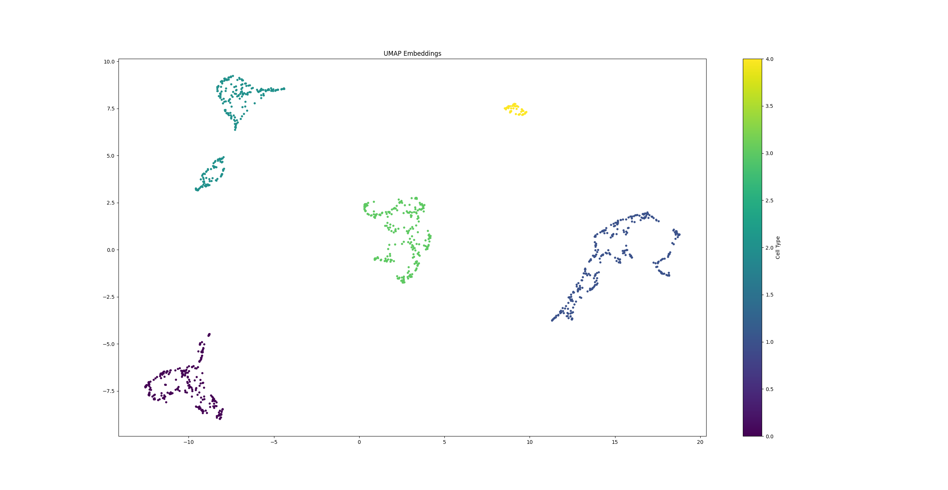
Autoencoder Results (UMAP)
Embedding size: 128 (100% train)
silhouette score: 0.7595
classification accuracy: 100.00%
inter-cluster distance: 16.8972
intra-cluster distance: 2.2231

Slide 28
Conclusions

Slide 29
Conclusions
Optimal latent layer size:
64 (PCA), 128 (UMAP)
100% val. cl. accuracy when all data is used for autoencoder training
useful for subsequent ML ops when all class labels are predetermined
fully supervised training scenario
autoencoder should not be used for embeddings of previously unseen data (overtrain)
87.61% val. cl. accuracy for both PCA and UMAP (10% validation data)
satisfactory for PoC
More complex structures could be employed for larger datasets
++layers, ++neurons, CNN, LSTM, etc.

Slide 30
Thank You
www.branislavpopovic.com
branislav.popovic@live.com

